Slide 1
INFO1112 Tutorial
Week 9

Slide 2
Assignment 2 – things to focus on

Slide 3
Homework stuff
Homework 4 – going through interviews today

Slide 4
Brief summary of this week’s content

Slide 5

9.1 – Computer and Network Security
Three key things we want to have in network connections
Confidentiality
Interception protection
“Message is only readable by the intended party"
Integrity
Ensure data has not been tampered with
“Message is the same one that was sent”
Authenticity
Ensuring we know who the sender is and cannot dispute it is actually them
“We know who sent the message”

Slide 6

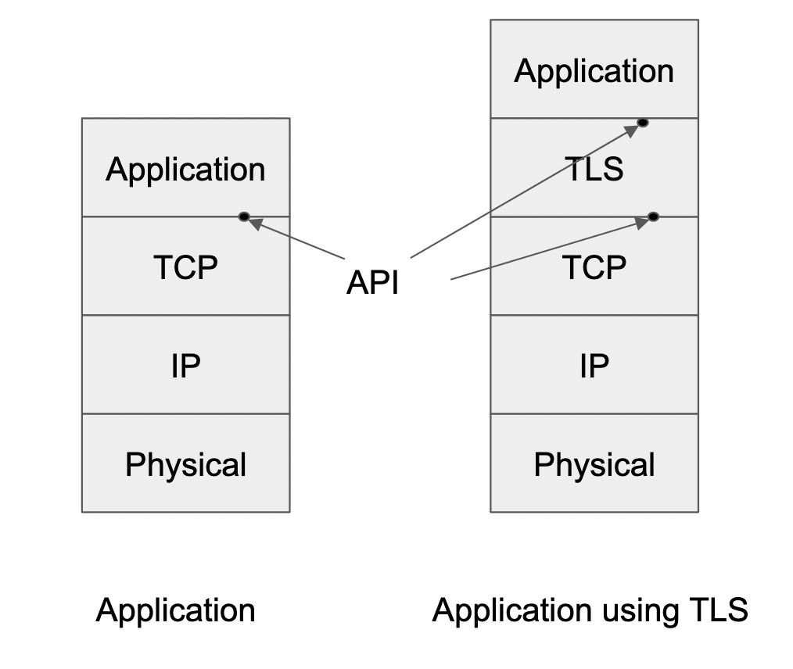

9.1 – Computer and Network Security
Security when browsing the web
By default, HTTP transmits data as plain text
Not secure for confidential information, like credentials!
HTTP has a secure version called HTTPS
Encrypts HTTP data using Transport Layer Security (TLS)
TLS sits between HTTP and TCP – effectively between application and transport layer
Encrypts HTTP data before it is passed to TCP, and, vice versa, decrypts TCP data before going to HTTP

Slide 7
9.1 – Computer and Network Security
Encryption – what is it?
Simple definition: systematic scrambling of data so that an interceptor cannot understand the data, but the recipient can unscramble it to get the original data.
Study and use of encryption is known as cryptology, which encompasses
cryptography: study of creating encrypted codes
cryptanalysis: study of encrypted codes to understand how they work and find improvements

Slide 8
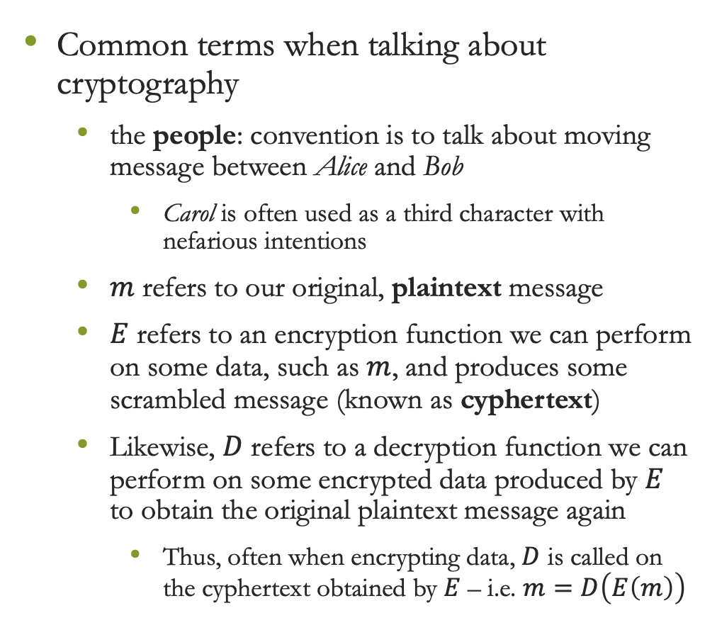
9.1 – Computer and Network Security
Common terms when talking about cryptography
the people: convention is to talk about moving message between Alice and Bob
Carol is often used as a third character with nefarious intentions
$m$ refers to our original, plaintext message
$E$ refers to an encryption function we can perform on some data, such as $m$, and produces some scrambled message (known as cyphertext)
Likewise, $D$ refers to a decryption function we can perform on some encrypted data produced by $E$ to obtain the original plaintext message again
Thus, often when encrypting data, $D$ is called on the cyphertext obtained by $E$ – i.e. $m=D\left(E\left(m\right)\right)$

Slide 9
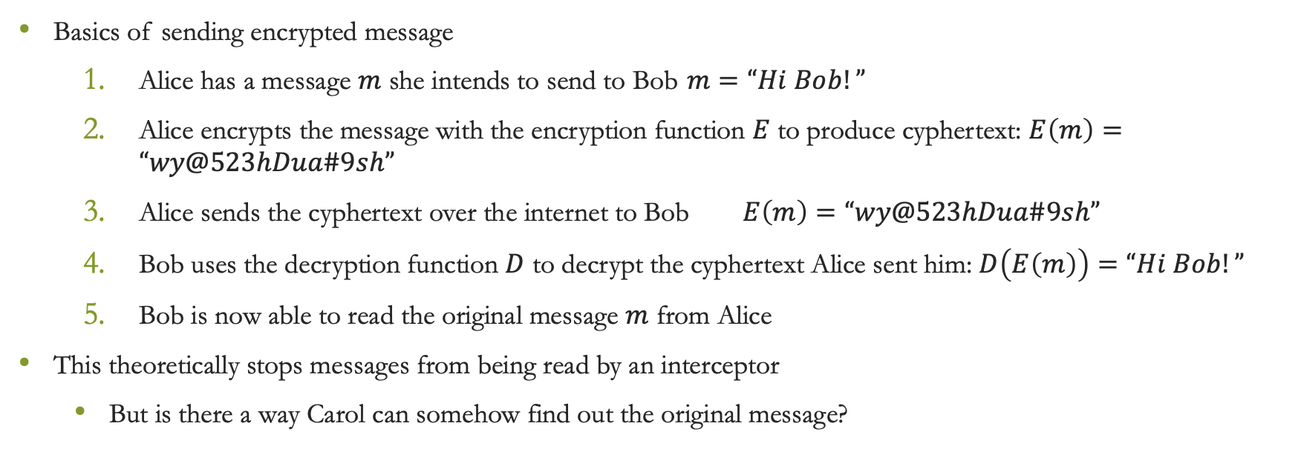
9.1 – Computer and Network Security
Basics of sending encrypted message
Alice has a message $m$ she intends to send to Bob $m=“Hi Bob!”$
Alice encrypts the message with the encryption function $E$ to produce cyphertext: $E\left(m\right)=“wy@523hDua\#9sh”$
Alice sends the cyphertext over the internet to Bob $E\left(m\right)=“wy@523hDua\#9sh”$
Bob uses the decryption function $D$ to decrypt the cyphertext Alice sent him: $D\left(E\left(m\right)\right)=“Hi Bob!”$
Bob is now able to read the original message $m$ from Alice
This theoretically stops messages from being read by an interceptor
But is there a way Carol can somehow find out the original message?
Carol wants to intercept the message here…

Slide 10
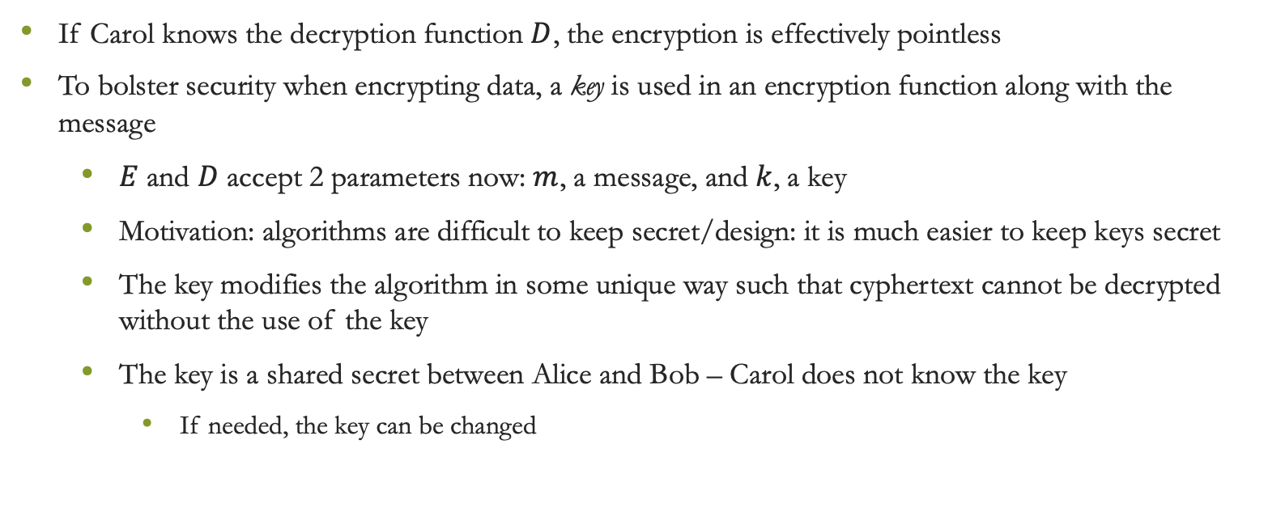
9.1 – Computer and Network Security
If Carol knows the decryption function $D$, the encryption is effectively pointless
To bolster security when encrypting data, a key is used in an encryption function along with the message
$E$ and $D$ accept 2 parameters now: $m$, a message, and $k$, a key
Motivation: algorithms are difficult to keep secret/design: it is much easier to keep keys secret
The key modifies the algorithm in some unique way such that cyphertext cannot be decrypted without the use of the key
The key is a shared secret between Alice and Bob – Carol does not know the key
If needed, the key can be changed

Slide 11
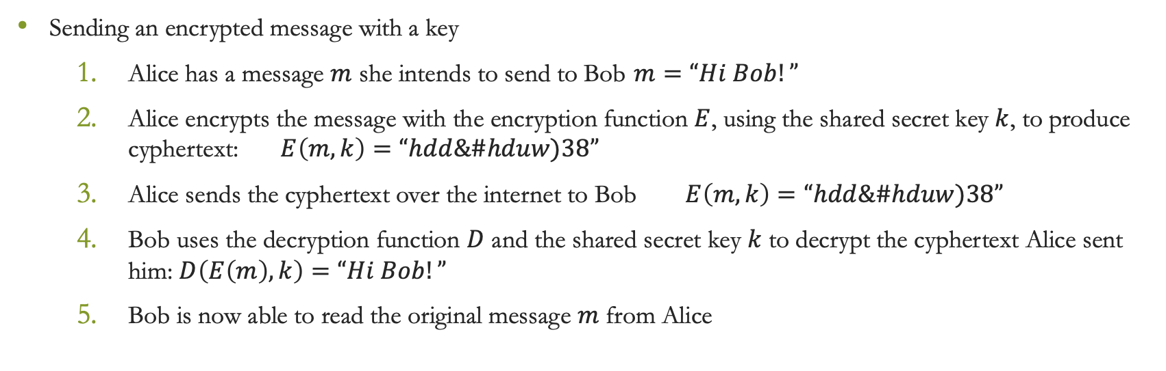
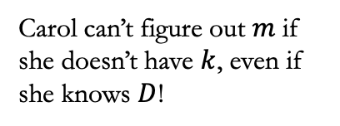
9.1 – Computer and Network Security
Sending an encrypted message with a key
Alice has a message $m$ she intends to send to Bob $m=“Hi Bob!”$
Alice encrypts the message with the encryption function $E$, using the shared secret key $k$, to produce cyphertext: $E\left(m,k\right)=“hdd\&\#hduw)38”$
Alice sends the cyphertext over the internet to Bob $E\left(m,k\right)=“hdd\&\#hduw)38”$
Bob uses the decryption function $D$ and the shared secret key $k$ to decrypt the cyphertext Alice sent him: $D\left(E\left(m\right),k\right)=“Hi Bob!”$
Bob is now able to read the original message $m$ from Alice
Carol can’t figure out $m$ if she doesn’t have $k$, even if she knows $D$!

Slide 12

9.2 – Integrity and Public Key Cryptography
The cypher functions shown in the previous slides rely on the same key being known to both Alice and Bob, but not Carol
Known as symmetric encryption – both $E$ and $D$ use the same key
But how can Alice give the key to Bob/vice versa?
Maybe:
Send over the internet?
Give it to Bob in-person?
Mail it on a USB to Bob?
What are the benefits/difficulties of each of the above approaches?
Perhaps a modified approach is needed for encryption?

Slide 13

9.2 – Integrity and Public Key Cryptography
Solution – use encryption where a secret key is only known to one party, known as asymmetric encryption
Forms basis of public key cryptography
Each party now has a unique set of 2 keys associated with them:
private key – secret key only known by the original party
public key – a key related, but different, to the original party’s private key

Slide 14

9.2 – Integrity and Public Key Cryptography
A person (say Alice) can share their public key publicly with everyone, e.g. on a website, for anyone to use
Another person (say Bob), wishing to send an encrypted message to Alice, produces cyphertext with an encryption algorithm $E$, and inputs the message $m$ and Alice’s public key $k_{pub}$
Alice can decrypt the message using $D$, inputting the cyphertext Bob produced, and her private key $k_{pri}$
A public key cryptography system has the following properties:
$D\left(E\left(m,k_{pub, A}\right),k_{pri,A}\right)=m$
It must be difficult to find $k_{pri,A}$ from knowing $k_{pub, A}$

Slide 15
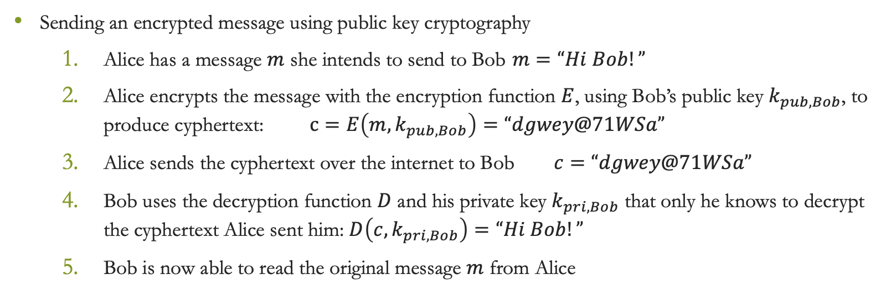
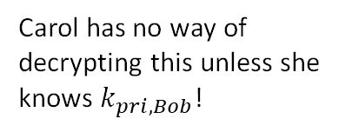
9.2 – Integrity and Public Key Cryptography
Sending an encrypted message using public key cryptography
Alice has a message $m$ she intends to send to Bob $m=“Hi Bob!”$
Alice encrypts the message with the encryption function $E$, using Bob’s public key $k_{pub,Bob}$, to produce cyphertext: $c=E\left(m,k_{pub,Bob}\right)=“dgwey@71WSa”$
Alice sends the cyphertext over the internet to Bob $c=“dgwey@71WSa”$
Bob uses the decryption function $D$ and his private key $k_{pri,Bob}$ that only he knows to decrypt the cyphertext Alice sent him: $D\left(c,k_{pri,Bob}\right)=“Hi Bob!”$
Bob is now able to read the original message $m$ from Alice
Carol has no way of decrypting this unless she knows $k_{pri,Bob}$!

Slide 16
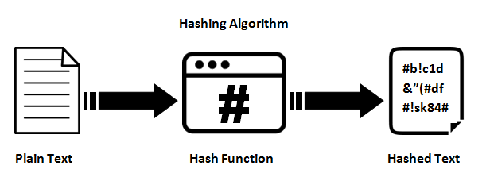
Hash Functions
A one-way function that takes an input and gives and always gives a seemingly random and unique output
E.g.
Hash(hello world) = a591a6d40bf420404a011733cfb7b190d62c65bf0bcda32b57b277d9ad9f146e
Hash(hello) = 71988c4d8e0803b451ba2ffd9679af5cf65efc2b754e8582850fafcbeb9d6e9b
Length should not change based on input

Slide 17

9.2 – Integrity and Public Key Cryptography
So we know we can keep a message confidential, but how do we know the message hasn’t been tampered with?
For all we know, Carol could intercept the transmission between Alice and Bob and send her own mangled message to Bob!
How can we check if a message is the original intended message?
Solution: hashing
One-way function which calculates checksum representing a hash or message digest for some data
Can’t get original data back from hash
A good hash function should have unique values for any input data
i.e. it should be very difficult for $H\left(m\right)=H(n)$
Example: SHA-256
When sending a message, Alice can send a hash to Bob of the intended contents along with the message
If the hash of Bob’s message from Alice does not match the hash Alice previously sent, it can be said the massage has been changed or tampered with during transmission

Slide 18
9.2 – Integrity and Public Key Cryptography
Common use of hashes: passwords
It would be a huge security flaw to store passwords as plaintext
Even if encryption was used, what would happen if the encryption was cracked?
Solution: only store hash of passwords
When someone logs in, the hash of the password they entered they entered is computed, and compared to the password hash in the database
Further security with hashing: salting
A salt is a random string of characters that is generated to go along with hashed data
This salt can then be used as part of the hashing function
This means that even if a password for 2 different users was the same, if the salt for each user is different, the hash is still unique
Thus, salts prevent:
attackers from being able to derive the hashing function from password hashes
using a user’s compromised hashed password in other locations
Salt is usually stored along with hashed password

Slide 19

9.3 – Digital Signatures
If our cryptography functions $D$ and $E$ can operate in any order, i.e. $D\left(E\left(m,k_{pub}\right),k_{pri}\right)=m=E\left(D\left(m,k_{pri}\right),k_{pub}\right)$, then we can use these to sign a message
Signing a message involves the sending party sending a signature of the message, $h$, generated by $h=D\left(m,k_{pri,sender}\right)$
The recipient can then check that $h$ is equal to $m$ by checking whether $m=E\left(h,k_{pub,sender}\right)$
This effectively verifies Alice as the sender, as only Alice has access to her private key

Slide 20
9.3 – Digital Signatures
Public key cryptography is much slower than using shared secret cryptography
However, we can utilise the best of both methods in order to send data confidentially
Alice can generate a shared secret key to use for communication with Alice and Bob, and send this key to Bob encrypted with Bob’s public key, and signed with Alice’s private key
Whilst anyone can see Alice and Bob’s public keys, the decryption and signature verification remains confidential, as private keys were used in the signing
Once Bob receives and decrypts/verifies the shared secret key sent by Alice, they can use this key in symmetric encryption to send data

Slide 21
9.3 – Digital Signatures
Problem: Alice or Bob’s public keys can be intercepted and modified by a third party to provide a false key, which can be used by someone like Carol to intercept messages
How can Alice or Bob pass their public keys to each other?
Use trusted intermediaries to share keys in person
Alice and Bob could prove their identity to a mutually trusted third party, who then issue a certificate along with the available public key stating they are convinced of their identity

Slide 22
9.3 – Digital Signatures
A digital certificate is a data structure that certifies a public key is owned by a specific person/organisation
Certificates are managed by certificate authorities (CAs) – trusted organisations which issue certificates
Certificates are signed by the private key of the CA, and can be checked using the CA’s public key
Example: HTTPS
When a URL beginning with https is requested, the web server sends a public key to the browser along with the signed certificate
The certificate is checked with the public key of the CA to verify its authenticity
Thus, the public key sent by the web server can be trusted

Slide 23
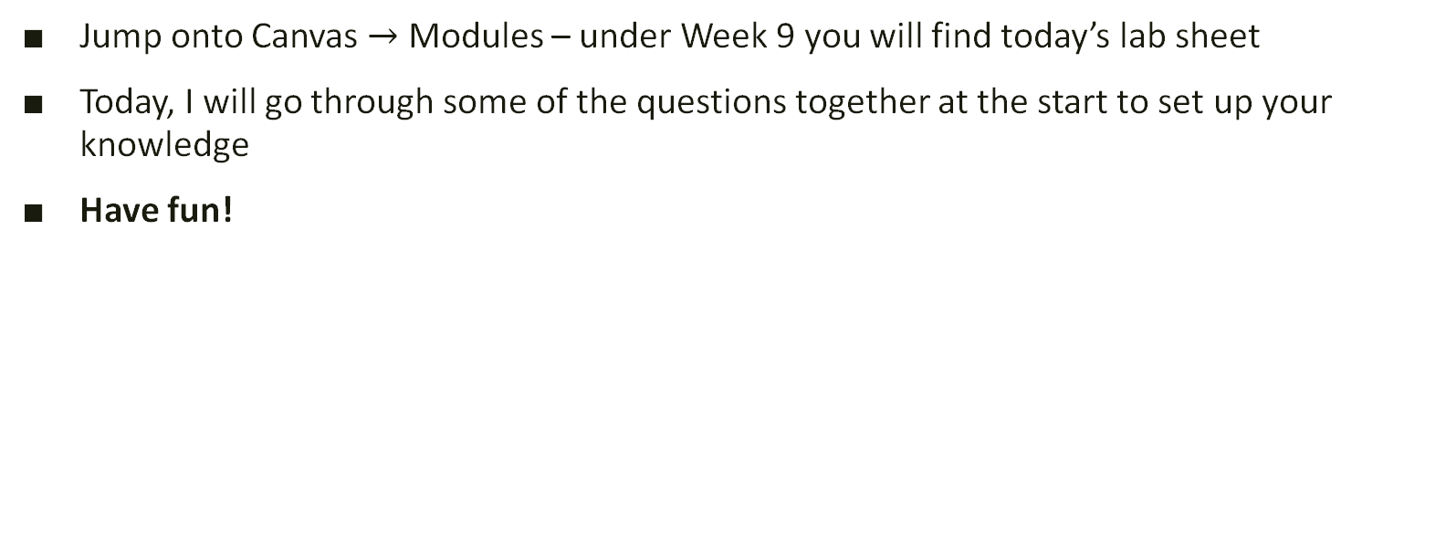
Lab exercises
Jump onto Canvas $→$ Modules – under Week 9 you will find today’s lab sheet
Today, I will go through some of the questions together at the start to set up your knowledge
Have fun!

Slide 24

Attendance
https://bit.ly/45btyQ4

